Slide 1


AZ-900
SMART QUIZ
BUILDER
Making Azure Fundamentals easier through interactive practice and African-context learning.
VIBE CODING HACKATHON 2026
Lovable • React • TypeScript • Supabase • GitHub

Slide 2
Testing isn’t
the same as learning.
Most quiz platforms reward recall — while learners still struggle to explain the concept, find weak spots, or know when they are exam-ready.
01
Memorize
without meaning
02
Weak areas
stay hidden
03
Readiness
feels uncertain

Slide 3
Practice that teaches
while it tests.
INTERACTIVE
QUIZZES
INSTANT
EXPLANATIONS
AZ-900 Smart Quiz Builder transforms exam prep from memorization into true understanding.
01
02
READINESS
TRACKING
AFRICAN
ANALOGIES
03
04

Slide 4

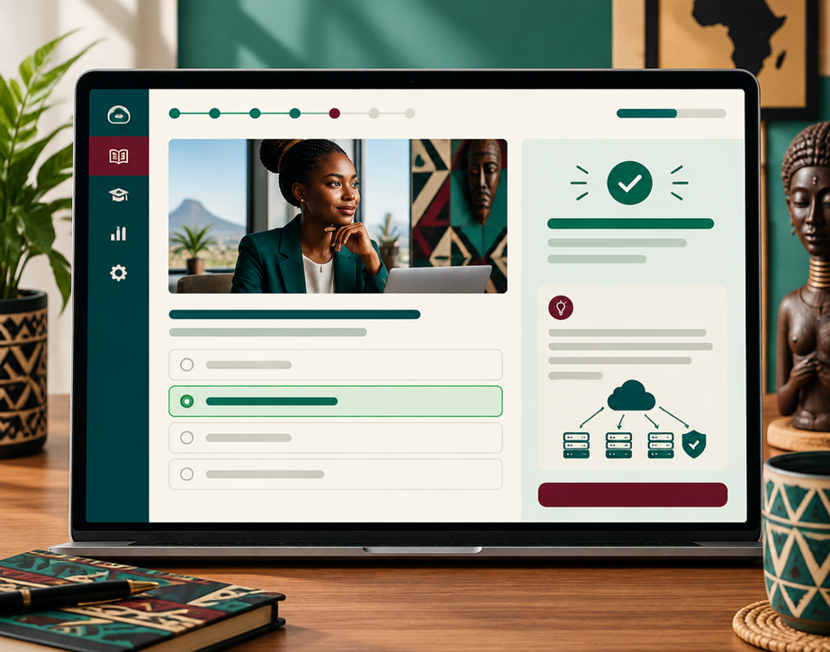
One question. Immediate clarity.
LANDING PAGE
QUIZ + EXPLANATION

Slide 5

Cloud concepts,
made local.
African Analogy Learning Mode connects abstract services to familiar everyday systems.
Virtual Machines
Renting a boda boda vs buying
Blob Storage
A cooperative warehouse
Load Balancer
A traffic officer directing flow
Scaling
More matatus at rush hour

Slide 6
A learning loop,
not a score screen.
Every answer becomes a signal for what to learn next.
Smart quiz engine
Performance dashboard
Readiness levels
Personalized insight
One focused question at a time
Attempted, correct, incorrect, score
Beginner → Intermediate → Exam Ready
Topic gaps + African analogies
Instant feedback
Validate and explain immediately

Slide 7
From click to insight.
A lean architecture built for fast iteration and measurable learning.
USER
LOVABLE
FRONTEND
SUPABASE
BACKEND
QUESTIONS
DATABASE
QUIZ
LOGIC
ANALYTICS
DASHBOARD
React • TypeScript • Tailwind CSS • Supabase • GitHub

Slide 8
Built. Integrated. Ready.
A working product shaped through disciplined collaboration.
DATABASE
READY
ANALYTICS
READY
GITHUB
WORKFLOW
UI
COMPLETE
QUIZ ENGINE
OPERATIONAL
ANALOGIES
DEVELOPED
Feature branches • Pull requests • Code reviews • Shared documentation

Slide 9
Confidence before
certification.
EDUCATIONAL VALUE
SOCIAL IMPACT
Concept-based learning
More effective exam preparation
Clearer readiness and confidence
Cloud literacy and digital skills
Accessible learning across Africa
New pathways to career growth

Slide 10
Next: a study system
that adapts to you.
AI STUDY COACH
FLASHCARDS
STUDY PLANNER
Personal tutoring + adaptive explanations
Active recall, built into the learning loop
Personal schedules with achievable milestones
ADVANCED ANALYTICS
MULTI-LANGUAGE
Deeper topic-performance signals
Broader access across Africa

